Slide 1
Chapter 7
Independent-Sample t-Test

Slide 2
Learning Objectives
Explain the concept of the independent-sample t-test
Describe the main assumptions of the independent-sample t-test
Describe the statistical significance of the independent-sample t-test
Formulate research problem and design hypotheses for the independent-sample t-test
Describe the concept of one-tailed and two-tailed conditions

Slide 3
Demonstrate the steps used in SPSS to execute the independent-sample t-test
Explain how to analyse and interpret the SPSS outputs of the independent-sample t-test
Describe the formulae and calculations of the independent-sample t-test
Explain how to convert categories of an independent variable into two desired groups to compute the independent-sample t-test
Report the final results of the independent-sample t-test

Slide 4
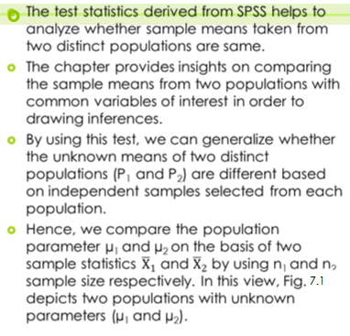
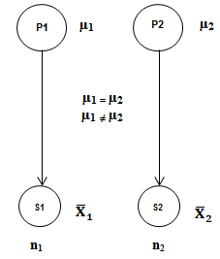
Introduction
Figure 7.1. Independent-Sample t-Test

Slide 5
Assumptions for Applying Independent-Sample t-Test
Independent samples: The samples used in t-test must be derived from two distinct populations such as male and female respondents, sales of Brand-A and Brand-B and the difference in packaging speed between old and new machines.
Normal distributed population: The dependent variable (metric scale) must be normal distributed in the target population.
Homogeneity of variance: Another important assumption is the equality of variance between the two distinct target groups.
Metric scale: The variable of interest is to be measured at interval or ratio scale, whereas the independent variable must be measured at nominal scale.

Slide 6
Summary of Assumptions
Table 7.1. Summary of Assumptions for Independent-Sample t-Test
Assumptions | Examine Approach | Measures/Tests
Independent samples | Methodology based | –
Normal distribution | Graphical method | Histogram, Box and whisker, Q–Q and P–P plots
 | Numerical method | Descriptive measures: Skewness and kurtosis
 |  | Statistical test: KS one sample and Shapiro–Wilk
Homogeneity of variance | Numerical method | Levene’s statistic
Metric data | Scale of measurement | –

Slide 7
Framing Hypotheses
Hypothesis for Two-tailed Condition: We envisage merely the difference of means between the two populations irrespective of considering a specific direction (either positive or negative) in the alternative hypothesis.
Null hypothesis H₀: µ₁ = µ₂
(Population means are same for both the groups.)
Alternative hypothesis H_{a}: µ₁ ≠ µ₂
(Population means are not same for both the groups.)

Slide 8
Hypothesis for One-tailed Condition: When we are interested to detect whether the mean of one group is higher than the other or vice-versa.
Null hypothesis H₀: µ₁ = µ₂
(Population means are same for both the groups.)
Alternative Hypothesis H_{a1}: µ₁ < µ₂
(Population mean of the first group is lower than the second group.)
H_{a2}: µ₁ > µ₂
(Population mean of the first group is greater than the second group.)

Slide 9
Statistical Significance
Statistical significance in SPSS is used in taking the decision whether to reject or not reject the null hypothesis based on the respective probabilistic (p) value at certain LoS. The p-value is labeled as Sig. (2-tailed) in SPSS-generated output results.
The rule of thumb for rejecting the null hypothesis is based on the p-value at pre-fixed LoS. In case the p-value created by the SPSS is less than 0.05 (p < 0.05, 100 CI) and multiplied by 100 (at 5% LoS), or 0.10 (at 10% LoS), we reject the null hypothesis, otherwise do not reject if greater than the criterion value (p > 0.05).

Slide 10
Table 7.2. Decision for Null Hypothesis
Level of Significance | p-value Sig. (2-tailed) | Decision
5% (0.05) | Less than 0.05 | Reject the null hypothesis
 | More than 0.05 | Not to reject the null hypothesis

Slide 11
Independent-Sample t-Test (Two-tailed)
Independent-sample t-test in two-tailed condition is used for comparing the means of two distinct populations by considering the rejection of null hypothesis in either direction.
It is important to note that an independent variable is categorical (male:female and Asians:Europeans) and dependent variable is metric (interval/ratio) in nature. The mean scores will be computed for dependent variable by the software.

Slide 12
Executing Independent-Sample t-Test with SPSS Procedure
Assessing Normality
Exhibit 7.1. Use retail.sav » Menu bar » analyse » Non-parametric test » Legacy Dialogs » One-sample KS test » Price transfer to Test Variable(s) List » Click on Normal Distribution under Test Distribution » Click OK

Slide 13
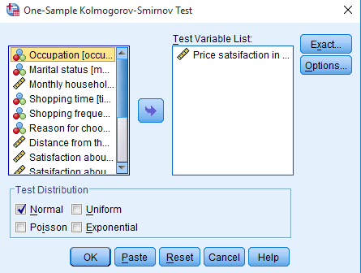
Examine the Assumptions
Table 7.3. Assessing Normality with One-Sample KS
 | N | Normal Parameters |  | K-S Z | Sig. (2-tailed)
 |  | Mean | Std. Deviation
Price Satisfaction | 120 | 5.65 | 2.56 | 0.79 | 0.063
The p-value as shown in the last column (Sig. (2-tailed)) is used to decide whether the data is approximate to normal. As the p-value is more than 0.05 (p > 0.05, 0.063) at 5% LoS, we fail to reject the null hypothesis of normality and conclude that price is normally distributed in target population.

Slide 14
SPSS Path for Descriptive Statistics, Levene’s Test and Measures of t-Test
Exhibit 7.2. Use retail.sav » Menu bar » analyse » Compare means » Independent-samples t-test » Select Price and transfer to dependent Test Variable(s) list » Select Gender and transfer to Grouping Variable » Click Define Groups » Type 1 in group 1 and type 2 in group 2 box » Continue » Click OK

Slide 15
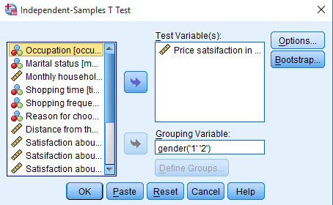
Null hypothesis H₀: µ_{male} = µ_{female}
(Mean rating of price satisfaction remains same for both the genders.)
Alternative hypothesis H_{a}: µ_{male} ≠ µ_{female}
(Mean rating of price satisfaction is not same for both the genders.)

Slide 16
Interpreting Outputs of Independent-Sample t-Test
Descriptors of Sample
 | Gender | N | Mean | Std. Deviation | Std. Error Mean
Price satisfaction | Male | 75 | 5.3 | 2.6 | 0.30
 | Female | 45 | 6.1 | 2.4 | 0.35

Slide 17
Test Statistics
 | Levene's Test |  | t-Test for Equality of Means
 | F | Sig. | t-Test | df | Sig. (2-tailed) | Mean Difference | Std. Error Difference | 95% Confidence Interval of the Difference
 |  |  |  |  |  |  |  | Lower | Upper
EV assumed | 0.251 | 0.617 | −1.6 | 118 | 0.100 | −0.79 | 0.47 | −1.7 | 0.15
EV not assumed |  |  | −1.6 | 98.8 | 0.093 | −0.79 | 0.46 | −1.7 | 0.13
EV: Equal variance.

Slide 18
The Sig. value (p-value) of Levene’s test appearing at left side of the table are used to examine the assumption of equal variance.
As the p-value (0.61) associated with Levene’s is more than 5% LoS (p > 0.05, 0.617), we fail to reject null hypothesis which stated that variability for two groups are equal.
The columns next to Levene’s test present the Sig. (2-tailed) value of t-test statistics as this value is more than 5% LoS (p > 0.05, 0.100).
Hence, we fail to reject null hypothesis of equal mean rating (µ_{male} = µ_{female}) and conclude that no significant difference occurs in the mean ratings of price satisfaction between male and female customers.

Slide 19
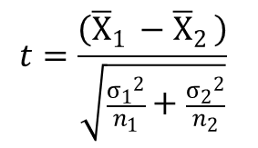
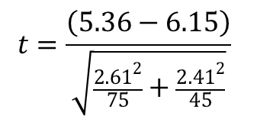
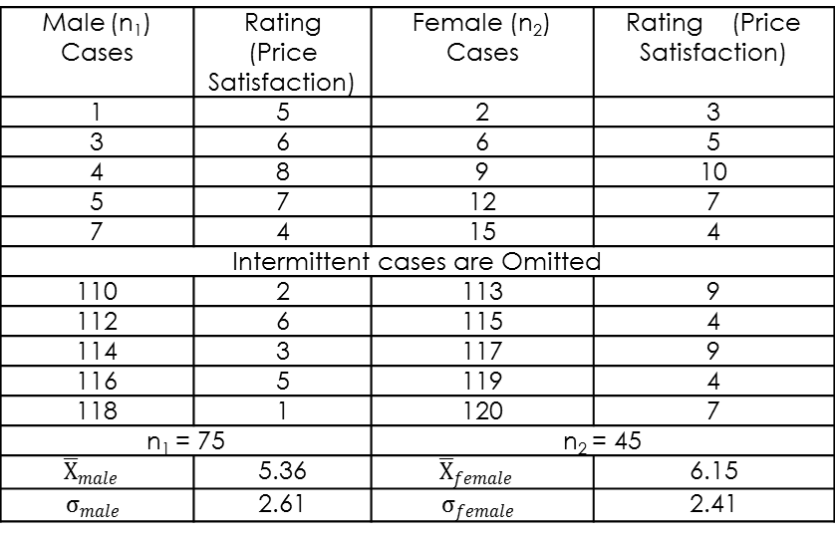
Sample Data and Important Formula for Independent Sample Statistics
Male (n₁) Cases | Rating (Price Satisfaction) | Female (n₂) Cases | Rating (Price Satisfaction)
1 | 5 | 2 | 3
3 | 6 | 6 | 5
4 | 8 | 9 | 10
5 | 7 | 12 | 7
7 | 4 | 15 | 4
Intermittent cases are Omitted
110 | 2 | 113 | 9
112 | 6 | 115 | 4
114 | 3 | 117 | 9
116 | 5 | 119 | 4
118 | 1 | 120 | 7
n₁ = 75 |  | n₂ = 45
 | 5.36 |  | 6.15
 | 2.61 |  | 2.41
Thus t-test statistics = -1.65

Slide 20
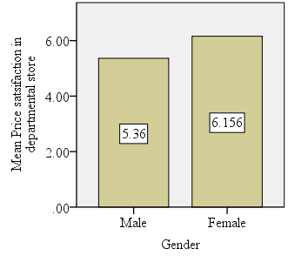
Graphical Presentation of Mean Difference
Exhibit 7.3. Use retail.sav » Menu bar » Graphs » Legacy Dialogs » Select Bar » Select Simple bar » Define » Select Other statistic » Transfer Price in Variable Box » Transfer Gender in Category Axis » Click OK

Slide 21
Independent-Sample t-Test (One-tailed)
In one-tailed condition, we are interested to determine whether µ₁ is significantly greater than µ₂ or vice-versa.
Null hypothesis H₀: µ_{male}= µ_{female}
(Male and female consumers are equally satisfied with price.)
Alternative hypothesis H_{a}: µ_{male} > µ_{female}
(Male consumers are more satisfied with price as compared to female.)
H_{a}: µ_{male} < µ_{female}
(Female consumers are more satisfied with price as compared to male.)

Slide 22
In one-tailed procedure, in continuation of previous analysis (Table 7.2b), the modified p-value will be 0.50 after dividing by 2 (0.100/2 = 0.50).
As this value is more than 0.05 (α level), the null hypothesis remains in force and concludes that male and female customers are equally satisfied with the price.

Slide 23
Converting Categories of Independent Variable into Desired Groups
In few cases, the independent variables have more than two categories; hence, we need to convert them into two distinct groups as per the requirement of analysis. The option cut point is available in the process of defining group membership and is used for this particular application.

Slide 24
Table 7.4. Categorization of Cases By Using option Cut point
Cut Point for Shopping frequency | Categorization of Cases or Subjects
 | Group-1 | Group-2
2 | Four categories (Once in a month, once in a week, more than once in week, and not fixed) | One category (First time)
3 | Three categories (once in a week, more than once in week, and not fixed) | Two categories (First time and once in a month)
4 | Two categories (more than once in week, and not fixed) | Three categories (First time, once in a month and once in a week)
5 | One category (Not fixed) | Four categories (First time, once in a month, once in a week, more than once in week)

Slide 25
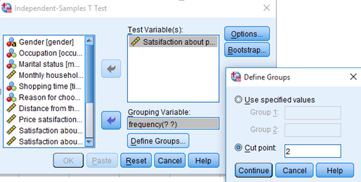
Categorization of Independent Variable
Exhibit 7.4. Use retail.sav » Menu bar » analyse » Compare means » Independent-samples t-test » Select Promotion and transfer to dependent Test Variable(s) list » Select shopping frequency and transfer to Grouping Variable » Click Define Groups » Type 2, 3, 4 and 5 one-by-one in Cut point » Continue » Click OK

Slide 26
Results of Categorization
Table 7.5. Group-wise Statistics
Group | N | Mean | Std. Deviation | Levene’s Test Statistics | EV Assumed (Yes/No) | t-Test Statistics | Decision for H₀ Hypothesis
>=2; <2 | 98 | 7.09 | 2.6 | F = 9.6 (0.002) | No | −1.94 (0.054) | Reject
 | 22 | 8.22 | 1.5
>=3; <3 | 79 | 7.15 | 2.61 | F = 3.48 (0.06) | Yes | −0.9 (0.37) | Not to Reject
 | 41 | 7.58 | 2.26
>=4; <4 | 40 | 7.15 | 2.74 | F = 2.2 (0.134) | Yes | −0.4 (0.64) | Not to Reject
 | 80 | 7.37 | 2.38
>=5; <5 | 10 | 9.0 | 1.49 | F = 5.8 (0.017) | No | 2.2 (0.024) | Reject
 | 110 | 7.1 | 2.51

Slide 27
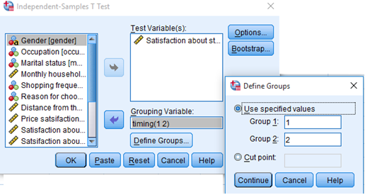
Converting any Two Categories into Distinct Groups
Exhibit 7.5. Use retail.sav » analyse » Compare means » Independent-samples t-test » Select » Staff service and transfer to dependent Test Variable(s) list » Select shopping time and transfer to Grouping Variable » Click Define Groups » Type 1 in Group 1 and type 2 in Group 2 box » Continue » Click OK

Slide 28
Descriptors for Subgroups
Table 7.6. Descriptors of Subgroups: Specific Categories
 | Shopping Time | N | Mean | Std. Deviation | Std. Error Mean
Staff service | Early in morning | 33 | 4.6 | 2.5 | 0.43
 | Afternoon | 14 | 7.0 | 2.4 | 0.65

Slide 29
Test Statistics
Null hypothesis H₀: µ₁ = µ₂
(Both groups of customers are equally satisfied with staff service.)
Alternative hypothesis H_{a}: µ₁ ≠ µ₂
(Both groups of customers are not equally satisfied with staff service.)

Slide 30
Table 7.7. Independent-Sample Test Statistics: Specific Categories
 | Levene's Test |  | t-test for Equality of Means for Staff Service
 | F | Sig. | t-Value | df | Sig. (2-tailed) | Mean Difference | Std. Error Difference | 95% Confidence Interval of the Difference
 |  |  |  |  |  |  |  | Lower | Upper
EV assumed | 0.636 | 0.42 | −3.0 | 45 | 0.003 | −2.46 | 0.79 | −4.07 | −0.85
EV not assumed |  |  | −3.1 | 25.12 | 0.005 | −2.46 | 0.79 | −4.09 | −0.83
EV: Equal variance.

Slide 31
The p-value of Levene’s test is more than 0.05 (0.42); hence, the condition of homogeneity of variance is assumed for the dependent variable. The column labelled Sig. (2-tailed) value is less than 0.05 (p < 0.05, 0.003). Hence, the null hypothesis of equal satisfaction is rejected and the decision would be in favour of alternative hypothesis. Thus, we conclude that significant difference exists between these two groups.

Slide 32
Reporting the Final Results of Independent-Sample t-Test
The assumption of normality has been examined for price considering to be the dependent variable. As the p-values associated with one-sample KS test (KS Z = 0.79, p > 0.05, 0.063) is more than 5% LoS, we fail to reject the null hypothesis of normal distribution.
The Sig. value (p-value) of Levene’s test [F = 0.251, p > 0.05, 0.617)] is more than 5% LoS; hence, we fail to reject null hypothesis, which stated that the variability for two groups is equal.
Finally, as the p-value associated with t-test statistics [t (118) = −1.6, p > 0.05, 0.100)] is more than the criterion value (5% LoS), we fail to reject the null hypothesis of equal mean scores of price (µ_{male} = µ_{female}) between male and female customers.

Slide 33
Key Terms
Box and whisker Confidence interval descriptive statistics Equal Variance Homogeneity of variance Independent Sample Independent sample t-test KS- one sample level of significance | Levene’s test Normal distribution Null and alternative hypothesis Q-Q and P-P plots Sahpiro- Wilk Statistical Significance Two and One-tailed condition

